Slide 1
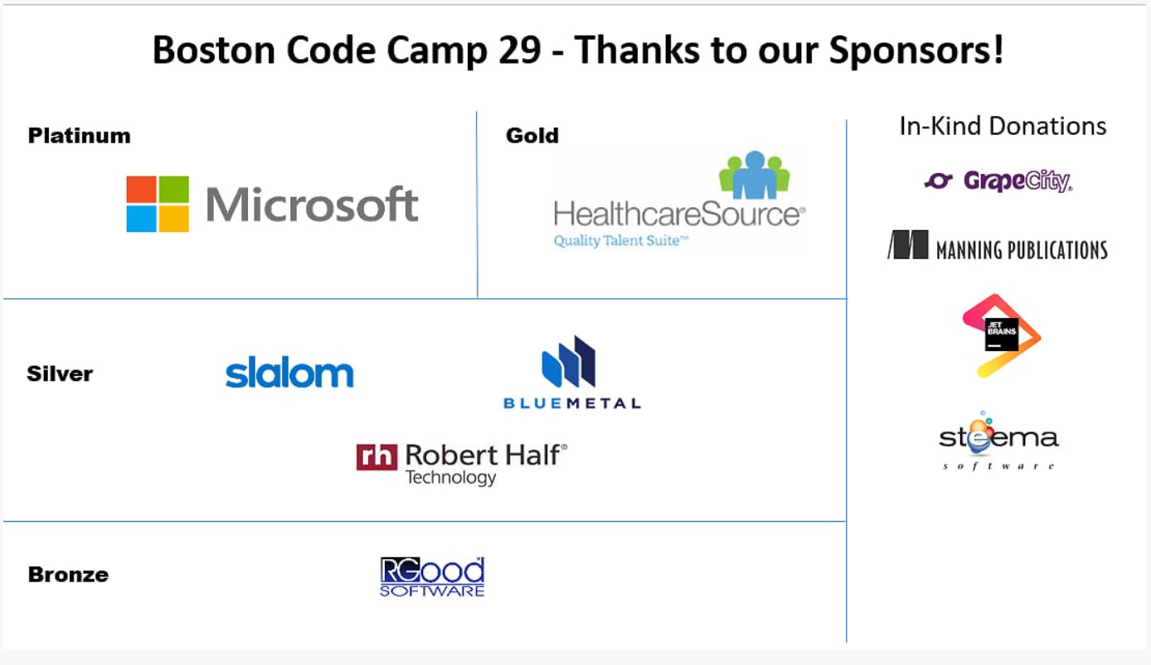
Notes:
Present Overview of Test Driven Development
Thank sponsors for providing snacks and lunch to make the day more enjoyable

Slide 2
Test Driven Development
Jacob Elkins
Curry College
Notes:
Increase the size of my name!!!!!
Add curry college
Make it more legible
Talk is about you!!!!

Slide 3
What is Test Driven development (TDD)?
Short repetitive development cycle
Requirements
Red - Green - Refactor
Notes:
brief overview of TDD
Software development technique that relies on a development cycle repeated over and over again as each requirement is implemented into the program
Uses the red green refactor cycle for testing and implementing requirements

Slide 4
Red – Green - Refactor
Red
Create test
Test fails – no code
Green
Code
Test Passes
Refactor : as needed
Improve the design
Avoid code duplication
CREATE TEST
TEST FAILS
REFACTOR
RUN TEST
WRITE CODE
Notes:
Bob Martin
- create a test to fulfill requirement being implemented
Test will fail
Write just enough code to fulfill requirement
If the test fails, look back at the test and code that was written for errors
Restructure code to follow clean code principles
Avoid code functionality duplications (duplicate code)

Slide 5
RED: Create test and make it fail
CREATE TEST
What is the requirement?
Test what the code is suppose to do
Run test
Once failed, Red is completed
TEST FAILS
Notes:
Think what the requirement needs to accomplish in the program
Write a test that tests what the requirement will do in the program
Run the test and it must fail
If the test passes, the developer possibly has written a bad test and not following proper TDD principles

Slide 6
GREEN: make the test pass
WRITE CODE
Minimal code
Pass test
Pass all tests
RUN TEST
Notes:
Write as little code as nessecary to fulfill the requirement being implemented because anything more could allow for untested code.
Make sure the test passes, if not revisit test suite and code to determine where we went wrong
Once it passes, rerun entire test suite to make sure everything is still passing with no unanticipated consequences

Slide 7
Refactor: As Needed
Single Responsibility
No code clones
Pass all tests
Improve the overall solution
Repeat cycle: as needed
Keep cycles short
REFACTOR
Notes:
Single responsibility because it follows SOLID design principles
Eliminate code clones to make maintenance easier
Make sure all tests are still passing when your refactoring (any time you make a change RUN A TEST)
Allows for easier maintenance and readable code
as each requirement is being implemented, a developer can consider a release

Slide 8
Benefits
Constant feedback
Documentation
Understanding requirements and solution
Ensures easier maintenance
No unanticipated consequences
Notes:
-Constant feedback that your program is still running and working properly
-provides documentation of what requirements are being implemented
-allows for a better understanding of the requirements
-ensures for easier maintenance due to clean code and more readable code

Slide 9
Jacob elkins
Curry College
Senior
Software Development
jelkins2014@students.curry.edu
www.linkedin.com/in/jacob-elkins
Notes:
Name bigger no bullet
no contact slide title (jacob elkins as title)
white space bewteen major and email and email and link

